Slide 1
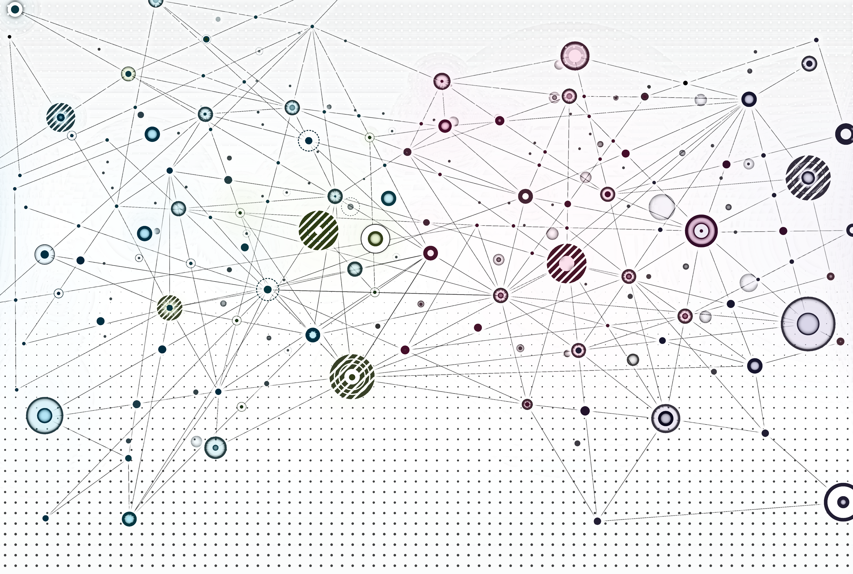
Shallow Node Embeddings

Slide 2
Overview
Motivation
Shallow node embedding framework
Node embedding methods
Factorization approaches
Random walk approaches
Graph embedding
Limitations of matrix factorization and random walk embeddings

Slide 3
Motivation

Slide 4
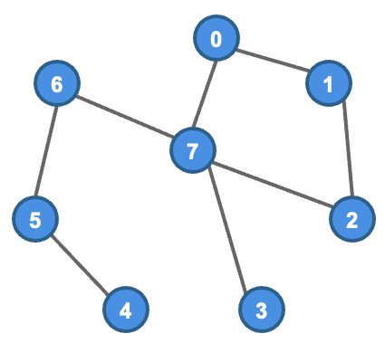
Previous lab – Machine learning with engineered features
In a standard machine learning approach, we extract mathematically formulated metrics from an input graph to train and make inferences with a statistical learning model
As with many other areas (e.g., computer vision, natural language processing), it is frequently beneficial to automate feature learning and bypass feature engineering
Input graph
Engineered Features (centrality, cliques, k-cores, diameter, etc)
Machine learning algorithm
Inference

Slide 5
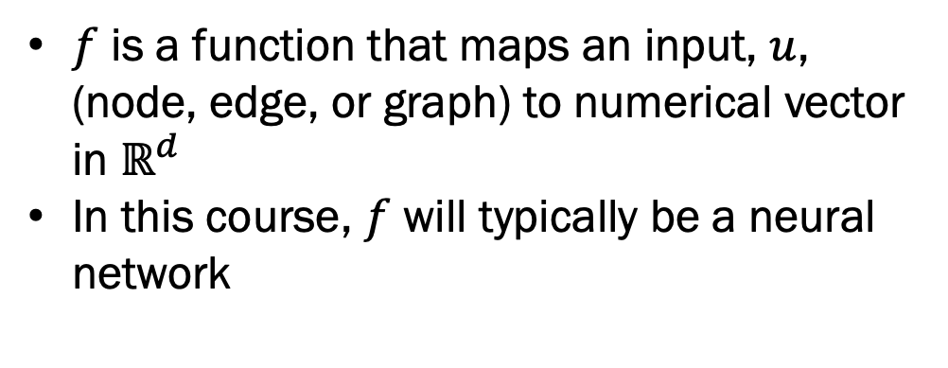
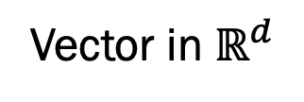
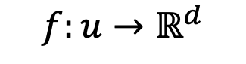
Latent representation learning for graphs
We would like to learn node, edge, and graph representations (embeddings) that are useful for many tasks
$$f:u→ℝ^{d}$$
Vector in $ℝ^{d}$
$f$ is a function that maps an input, $u$, (node, edge, or graph) to numerical vector in $ℝ^{d}$
In this course, $f$ will typically be a neural network

Slide 6
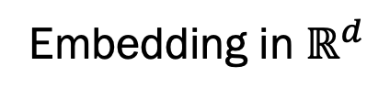
Why learn embeddings?
Eliminates reliance on handcrafted features
May capture network information that is not in engineered features
Potentially useful for many downstream tasks
Pretraining with self-supervised learning can reduce labeled data requirements for downstream tasks
Embedding in $ℝ^{d}$
Downstream Tasks
Node classification
Graph classification
Clustering
Graph generation
... and so on
Pre-trained node or graph via self-supervised learning

Slide 7
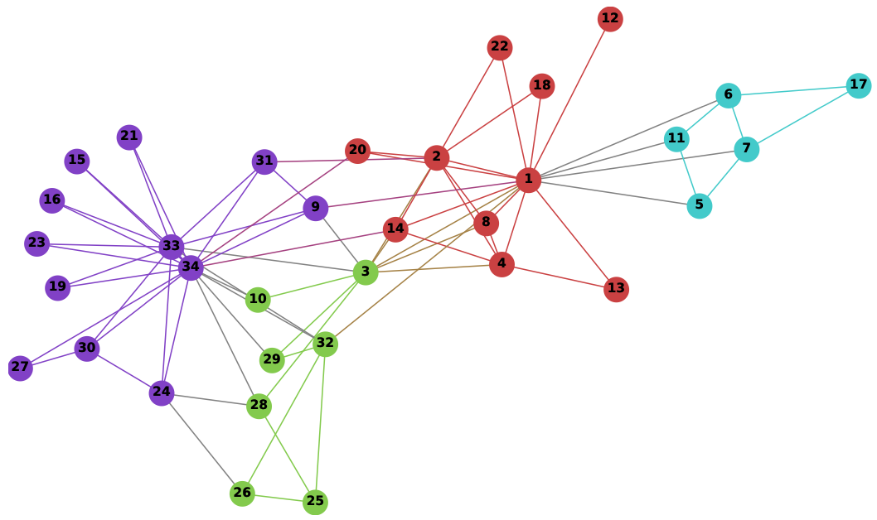
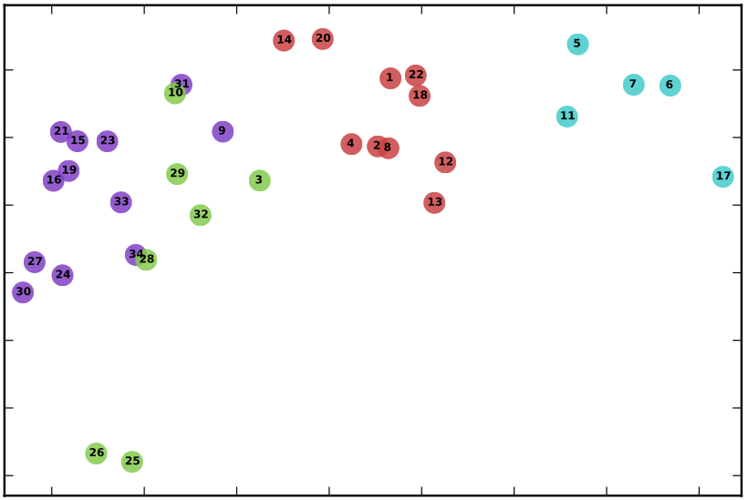
Example node embeddings
Image credit: Perozzi 2014
Image credit: Perozzi 2014
Embeddings in $ℝ^{2}$ for Zachery’s Karate network. Notice how community structure of the graph is maintained by the embeddings.

Slide 8
Shallow Node Embedding Framework

Slide 9
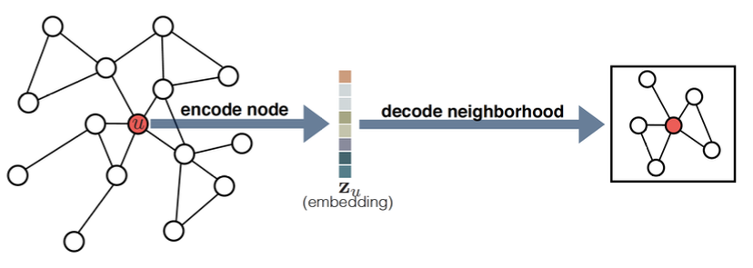
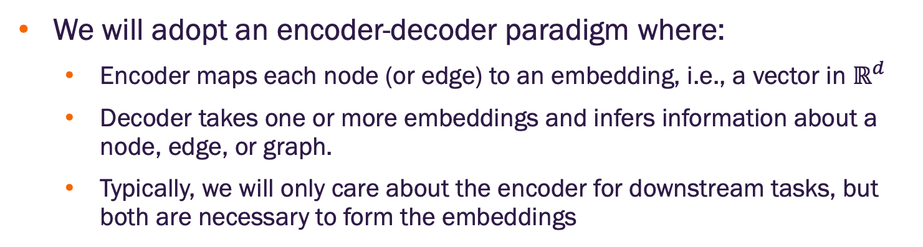
Encoder-decoder conceptual description
We will adopt an encoder-decoder paradigm where:
Encoder maps each node (or edge) to an embedding, i.e., a vector in $ℝ^{d}$
Decoder takes one or more embeddings and infers information about a node, edge, or graph.
Typically, we will only care about the encoder for downstream tasks, but both are necessary to form the embeddings
Image credit: Hamilton 2020

Slide 10
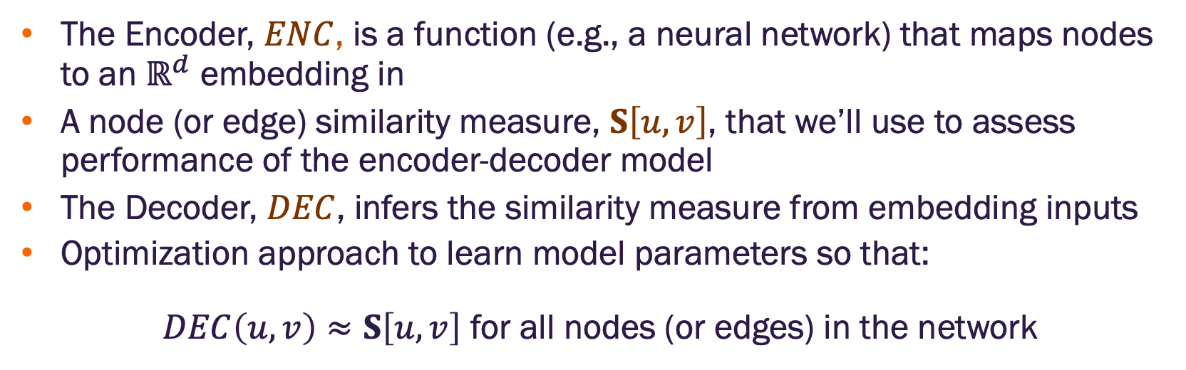
Encoder-decoder components
The Encoder, $ENC$, is a function (e.g., a neural network) that maps nodes to an $ℝ^{d}$ embedding in
A node (or edge) similarity measure, $S\left[u,v\right]$, that we’ll use to assess performance of the encoder-decoder model
The Decoder, $DEC$, infers the similarity measure from embedding inputs
Optimization approach to learn model parameters so that:
$DEC\left(u,v\right)≈S\left[u,v\right]$ for all nodes (or edges) in the network

Slide 11
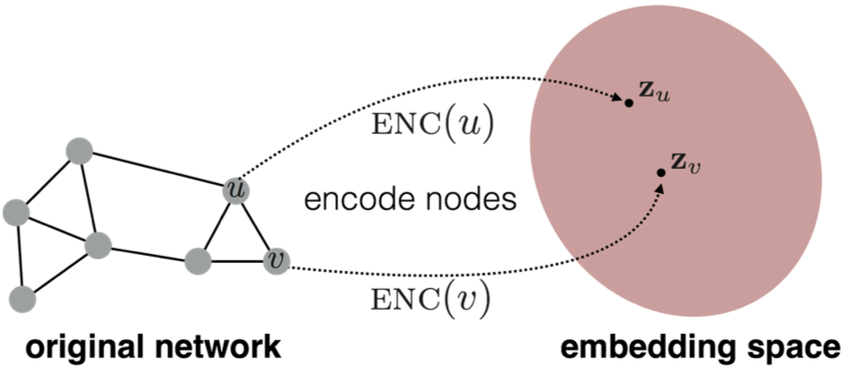
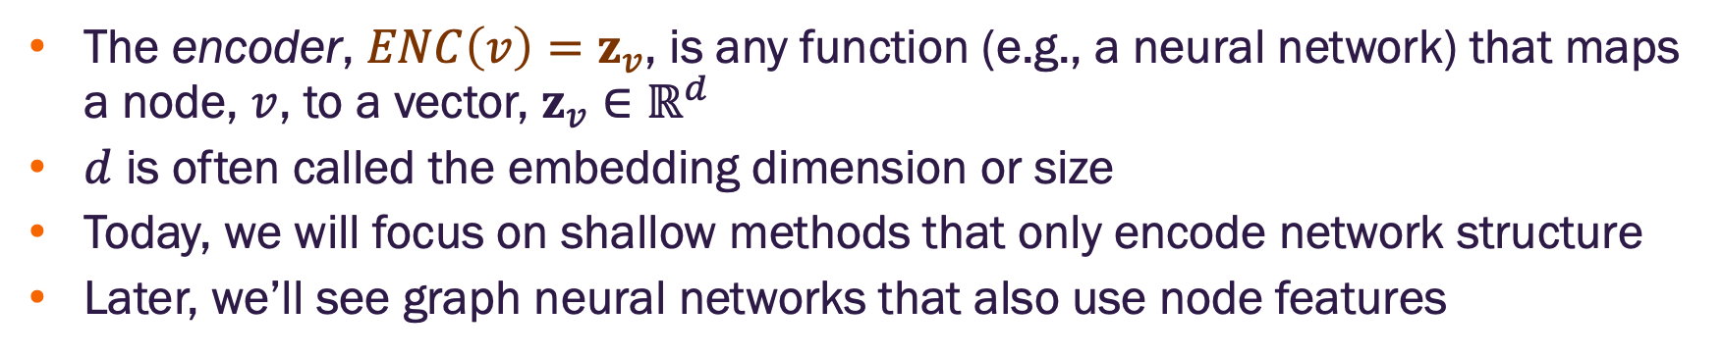
Encoder concept in detail
The encoder, $ENC\left(v\right)=z_{v}$, is any function (e.g., a neural network) that maps a node, $v$, to a vector, $z_{v}∈ℝ^{d}$
$d$ is often called the embedding dimension or size
Today, we will focus on shallow methods that only encode network structure
Later, we’ll see graph neural networks that also use node features
Image credit: Hamilton 2020

Slide 12
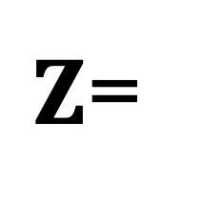
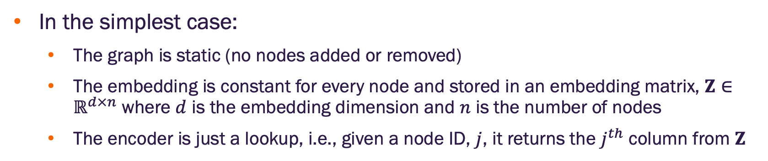
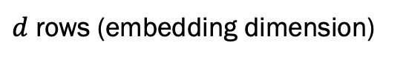
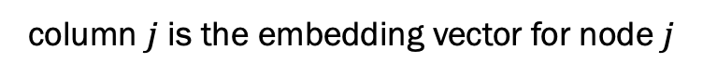
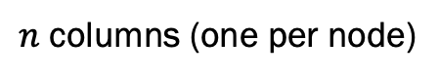
Encoder as a lookup function
In the simplest case:
The graph is static (no nodes added or removed)
The embedding is constant for every node and stored in an embedding matrix, $Z∈ℝ^{d×n}$ where $d$ is the embedding dimension and $n$ is the number of nodes
The encoder is just a lookup, i.e., given a node ID, $j$, it returns the $j^{th}$ column from $Z$
column $j$ is the embedding vector for node $j$
$Z$=
$d$ rows (embedding dimension)
embedding
matrix
$n$ columns (one per node)

Slide 13
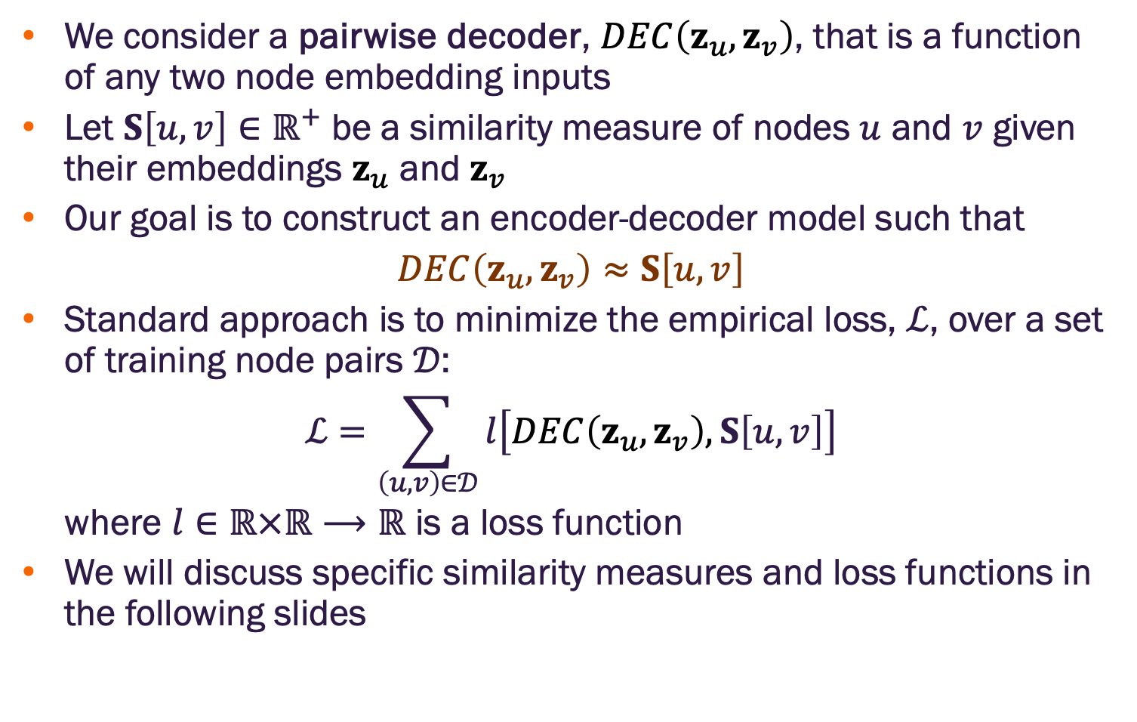
Embedding learning through loss optimization
We consider a pairwise decoder, $DEC\left(z_{u},z_{v}\right)$, that is a function of any two node embedding inputs
Let $S\left[u,v\right]∈ℝ^{+}$ be a similarity measure of nodes $u$ and $v$ given their embeddings $z_{u}$ and $z_{v}$
Our goal is to construct an encoder-decoder model such that
$$DEC\left(z_{u},z_{v}\right)≈S\left[u,v\right]$$
Standard approach is to minimize the empirical loss, $ℒ$, over a set of training node pairs $𝒟$:
$$ℒ=\sum_{\left(u,v\right)∈𝒟}{l\left[DEC\left(z_{u},z_{v}\right),S\left[u,v\right]\right]}$$
where $l∈ℝ×ℝ⟶ℝ$ is a loss function
We will discuss specific similarity measures and loss functions in the following slides

Slide 14
Shallow node embedding qualities
Unsupervised or self-supervised learning task (depends on specific method)
Node features are not used
Node labels are not used
Goal is to learn latent features that the decoder can use to reconstruct a similarity measure derived from network structure
The node embeddings are intended to be useful for any task where network structure is informative

Slide 15
Node Embedding with Matrix Factorization

Slide 16
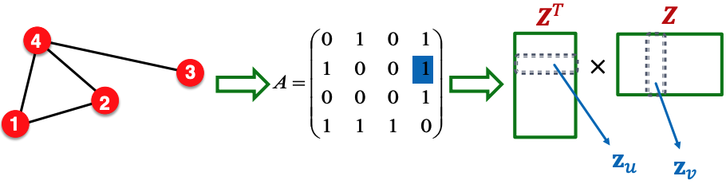
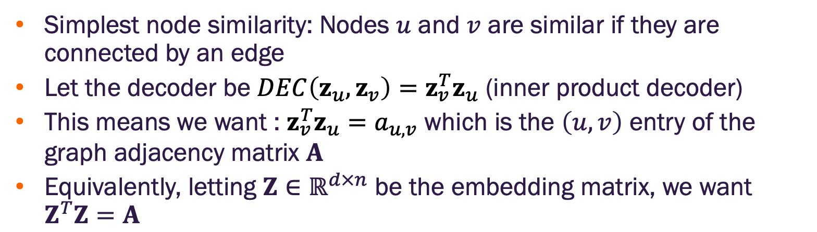
Matrix factorization embeddings
Simplest node similarity: Nodes $u$ and $v$ are similar if they are connected by an edge
Let the decoder be $DEC\left(z_{u},z_{v}\right)=z_{v}^{T}z_{u}$ (inner product decoder)
This means we want : $z_{v}^{T}z_{u}=a_{u,v}$ which is the $\left(u,v\right)$ entry of the graph adjacency matrix $A$
Equivalently, letting $Z∈ℝ^{d×n}$ be the embedding matrix, we want $Z^{T}Z=A$
Image credit: Jure Leskovec, http://cs224w.stanford.edu

Slide 17
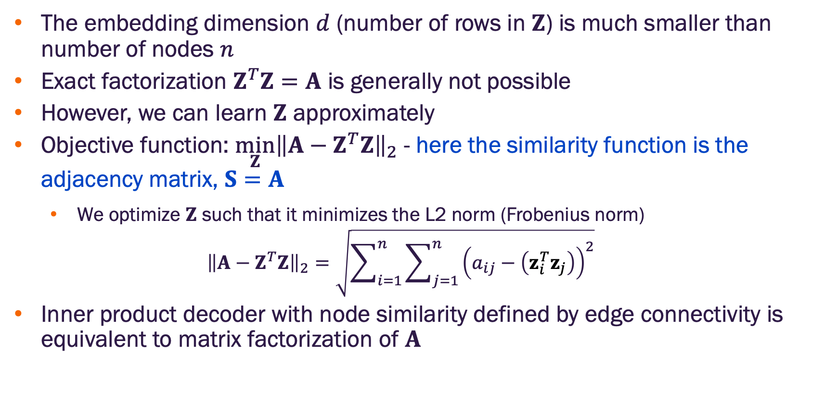
Matrix factorization embeddings
The embedding dimension $d$ (number of rows in $Z$) is much smaller than number of nodes $n$
Exact factorization $Z^{T}Z=A$ is generally not possible
However, we can learn $Z$ approximately
Objective function: $\min_{Z}{{\left\|A−Z^{T}Z\right\|}_{2}}$ - here the similarity function is the adjacency matrix, $S=A$
We optimize $Z$ such that it minimizes the L2 norm (Frobenius norm)
$${\left\|A−Z^{T}Z\right\|}_{2}=\sqrt{\sum_{i=1}^{n}{\sum_{j=1}^{n}{{\left(a_{ij}−\left(z_{i}^{T}z_{j}\right)\right)}^{2}}}}$$
Inner product decoder with node similarity defined by edge connectivity is equivalent to matrix factorization of $A$

Slide 18
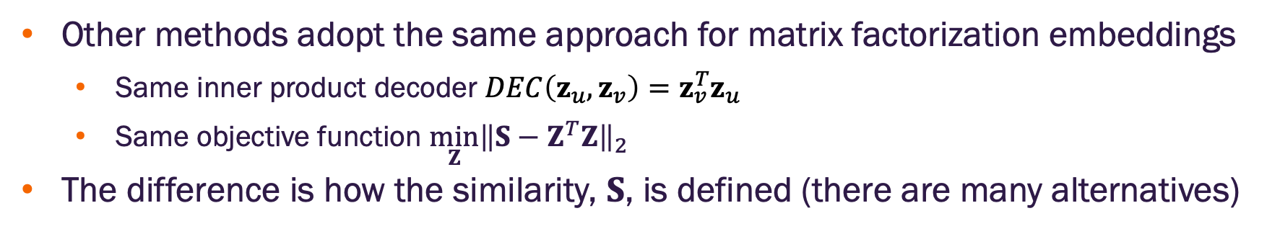
Matrix factorization embeddings
Other methods adopt the same approach for matrix factorization embeddings
Same inner product decoder $DEC\left(z_{u},z_{v}\right)=z_{v}^{T}z_{u}$
Same objective function $\min_{Z}{{\left\|S−Z^{T}Z\right\|}_{2}}$
The difference is how the similarity, $S$, is defined (there are many alternatives)

Slide 19
Node Embedding with Random Walks

Slide 20
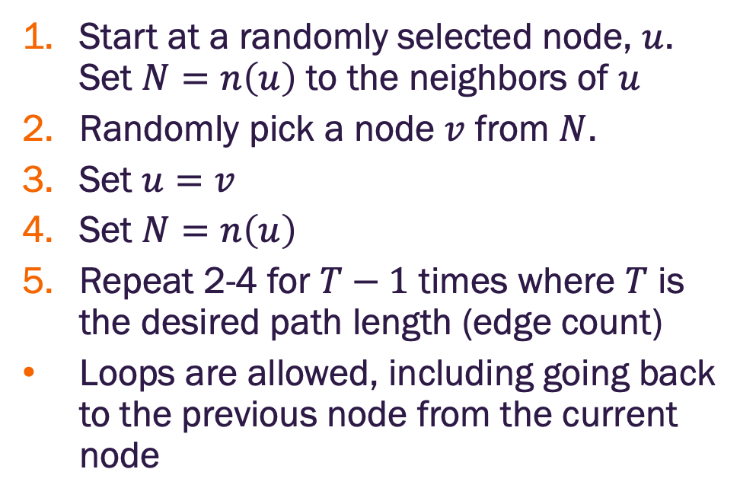
Random walk
Start at a randomly selected node, $u$. Set $N=n\left(u\right)$ to the neighbors of $u$
Randomly pick a node $v$ from $N$.
Set $u=v$
Set $N=n\left(u\right)$
Repeat 2-4 for $T−1$ times where $T$ is the desired path length (edge count)
Loops are allowed, including going back to the previous node from the current node
Step 3
Step 5
Step 4
Step 2
Step 1
Starting at node 7, and taking 5 random steps yields the walk:
7→2 →1 →0 →7 →6

Slide 21
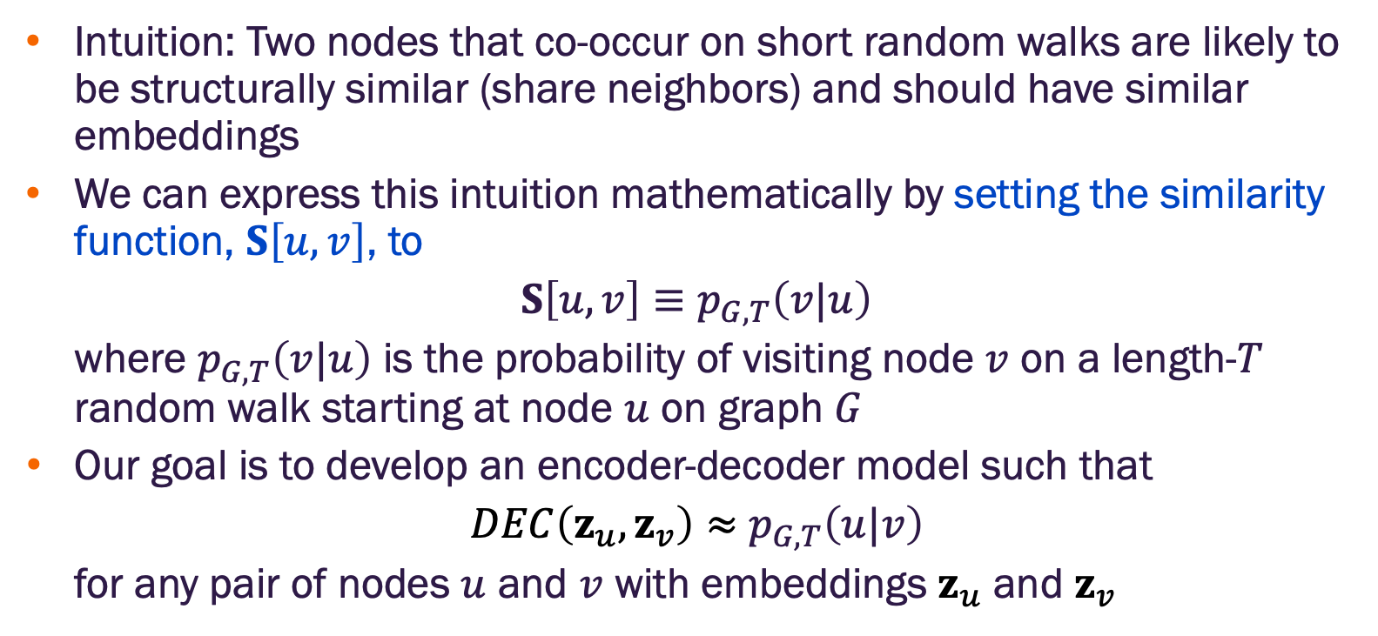
Random walk embedding concept
Intuition: Two nodes that co-occur on short random walks are likely to be structurally similar (share neighbors) and should have similar embeddings
We can express this intuition mathematically by setting the similarity function, $S\left[u,v\right]$, to
$$S\left[u,v\right]≡p_{G,T}\left(v|u\right)$$
where $p_{G,T}\left(v|u\right)$ is the probability of visiting node $v$ on a length-$T$ random walk starting at node $u$ on graph $G$
Our goal is to develop an encoder-decoder model such that
$DEC\left(z_{u},z_{v}\right)≈$ $p_{G,T}\left(u|v\right)$
for any pair of nodes $u$ and $v$ with embeddings $z_{u}$ and $z_{v}$

Slide 22
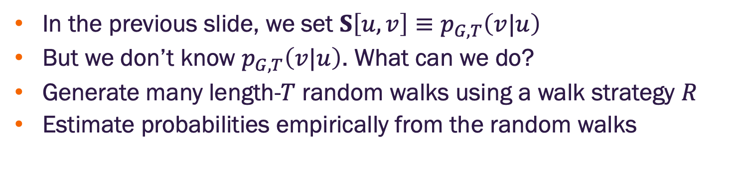
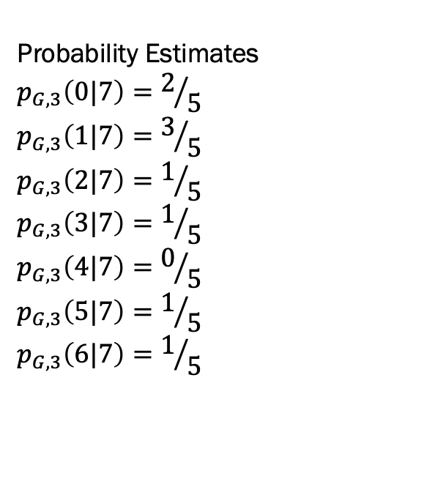
Random walk similarity measure
In the previous slide, we set $S\left[u,v\right]≡p_{G,T}\left(v|u\right)$
But we don’t know $p_{G,T}\left(v|u\right)$. What can we do?
Generate many length-$T$ random walks using a walk strategy $R$
Estimate probabilities empirically from the random walks
Length-3 Random Walks
7→2 →1
7→0 →1
7→3 →7
7→6→5
7→0 →1
Probability Estimates
$$p_{G,3}\left(0|7\right)=2/5$$
$$p_{G,3}\left(1|7\right)=3/5$$
$$p_{G,3}\left(2|7\right)=1/5$$
$$p_{G,3}\left(3|7\right)=1/5$$
$$p_{G,3}\left(4|7\right)=0/5$$
$$p_{G,3}\left(5|7\right)=1/5$$
$$p_{G,3}\left(6|7\right)=1/5$$

Slide 23
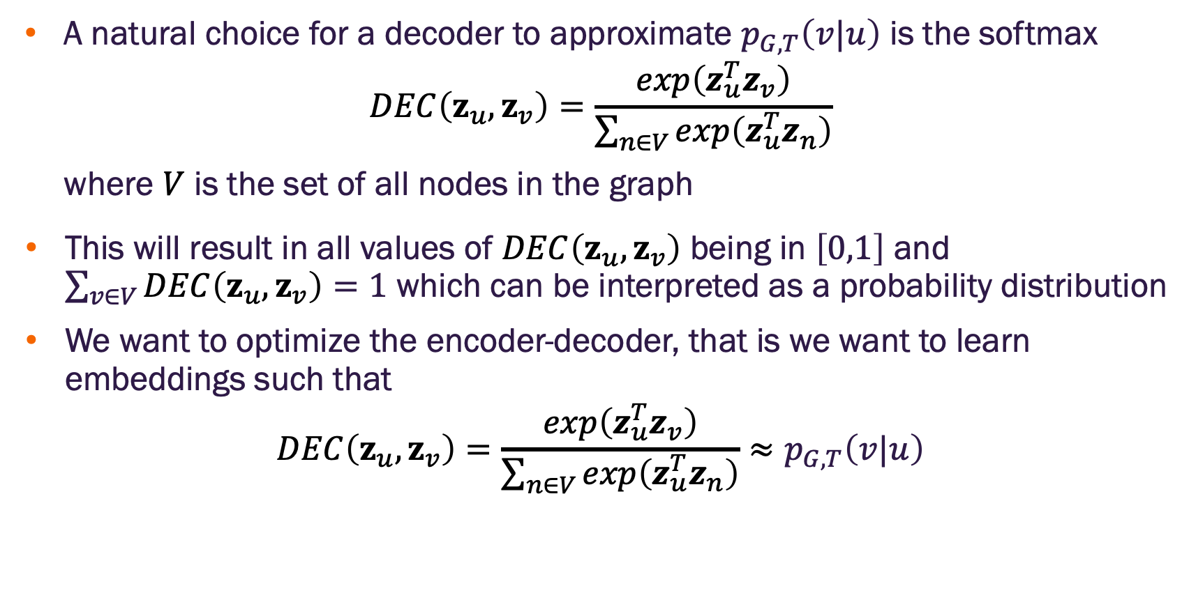
Random walk decoder
A natural choice for a decoder to approximate $p_{G,T}\left(v|u\right)$ is the softmax
$$DEC\left(z_{u},z_{v}\right)=\frac{exp\left(z_{u}^{T}z_{v}\right)}{\sum_{n∈V}{exp\left(z_{u}^{T}z_{n}\right)}}$$
where $V$ is the set of all nodes in the graph
This will result in all values of $DEC\left(z_{u},z_{v}\right)$ being in $\left[0,1\right]$ and $\sum_{v∈V}{DEC\left(z_{u},z_{v}\right)}=1$ which can be interpreted as a probability distribution
We want to optimize the encoder-decoder, that is we want to learn embeddings such that
$$DEC\left(z_{u},z_{v}\right)=\frac{exp\left(z_{u}^{T}z_{v}\right)}{\sum_{n∈V}{exp\left(z_{u}^{T}z_{n}\right)}}≈p_{G,T}\left(v|u\right)$$

Slide 24
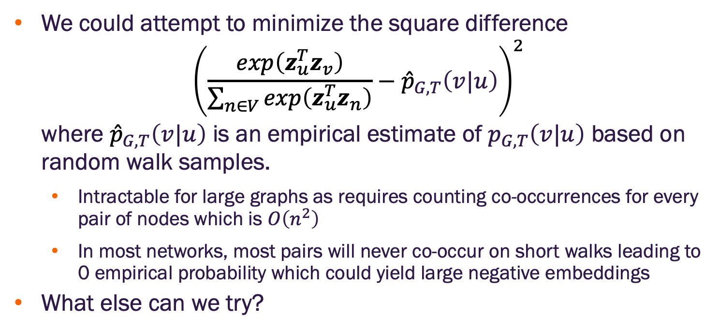
Naïve random walk embedding optimization
We could attempt to minimize the square difference
$${\left(\frac{exp\left(z_{u}^{T}z_{v}\right)}{\sum_{n∈V}{exp\left(z_{u}^{T}z_{n}\right)}}−{\hat{p}}_{G,T}\left(v|u\right)\right)}^{2}$$
where ${\hat{p}}_{G,T}\left(v|u\right)$ is an empirical estimate of $p_{G,T}\left(v|u\right)$ based on random walk samples.
Intractable for large graphs as requires counting co-occurrences for every pair of nodes which is $O\left(n^{2}\right)$
In most networks, most pairs will never co-occur on short walks leading to 0 empirical probability which could yield large negative embeddings
What else can we try?

Slide 25
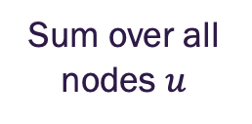
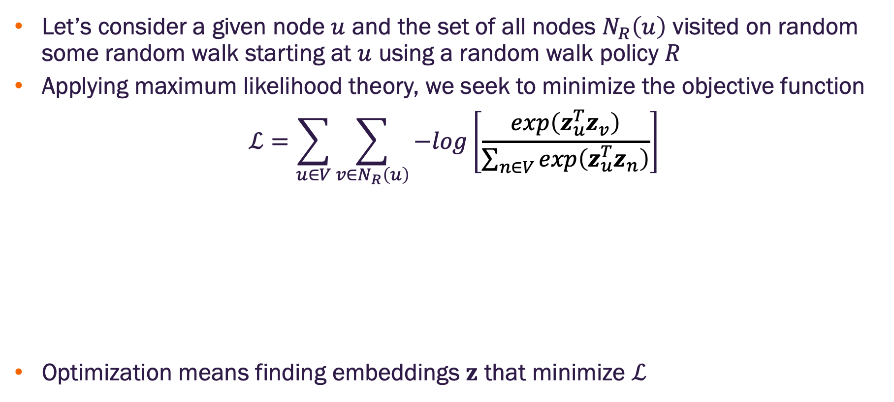
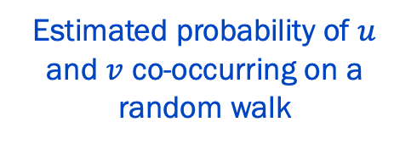
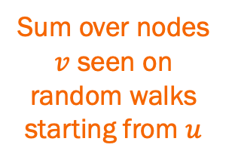
Random walk embedding optimization by maximum likelihood
Let’s consider a given node $u$ and the set of all nodes $N_{R}\left(u\right)$ visited on random some random walk starting at $u$ using a random walk policy $R$
Applying maximum likelihood theory, we seek to minimize the objective function
$$ℒ=\sum_{u∈V}{\sum_{v∈N_{R}\left(u\right)}{−log\left[\frac{exp\left(z_{u}^{T}z_{v}\right)}{\sum_{n∈V}{exp\left(z_{u}^{T}z_{n}\right)}}\right]}}$$
Optimization means finding embeddings $z$ that minimize $ℒ$
Sum over all nodes $u$
Sum over nodes $v$ seen on random walks starting from $u$
Estimated probability of $u$ and $v$ co-occurring on a random walk

Slide 26
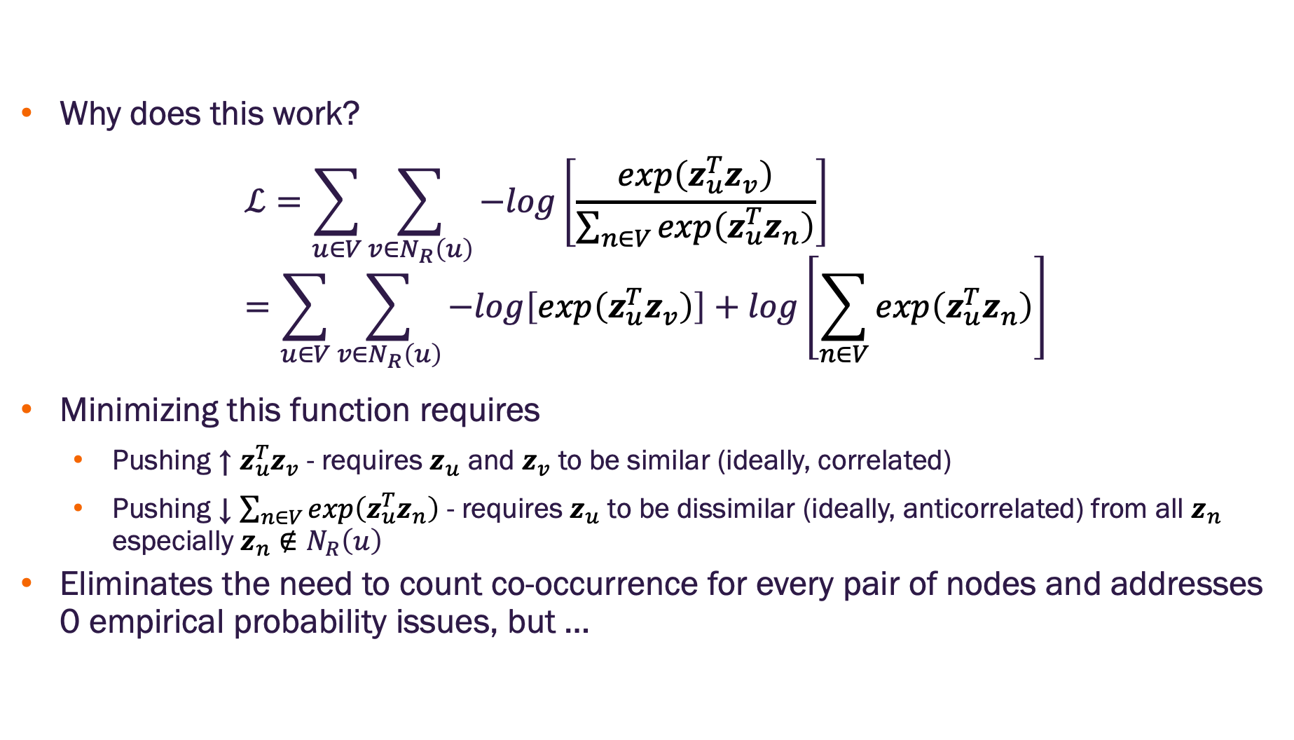
Random walk embedding optimization by maximum likelihood
Why does this work?
$$ℒ=\sum_{u∈V}{\sum_{v∈N_{R}\left(u\right)}{−log\left[\frac{exp\left(z_{u}^{T}z_{v}\right)}{\sum_{n∈V}{exp\left(z_{u}^{T}z_{n}\right)}}\right]}}=\sum_{u∈V}{\sum_{v∈N_{R}\left(u\right)}{−log\left[exp\left(z_{u}^{T}z_{v}\right)\right]+log\left[\sum_{n∈V}{exp\left(z_{u}^{T}z_{n}\right)}\right]}}$$
Minimizing this function requires
Pushing ↑ $z_{u}^{T}z_{v}$ - requires $z_{u}$ and $z_{v}$ to be similar (ideally, correlated)
Pushing ↓ $\sum_{n∈V}{exp\left(z_{u}^{T}z_{n}\right)}$ - requires $z_{u}$ to be dissimilar (ideally, anticorrelated) from all $z_{n}$ especially $z_{n}∉N_{R}\left(u\right)$
Eliminates the need to count co-occurrence for every pair of nodes and addresses 0 empirical probability issues, but …

Slide 27
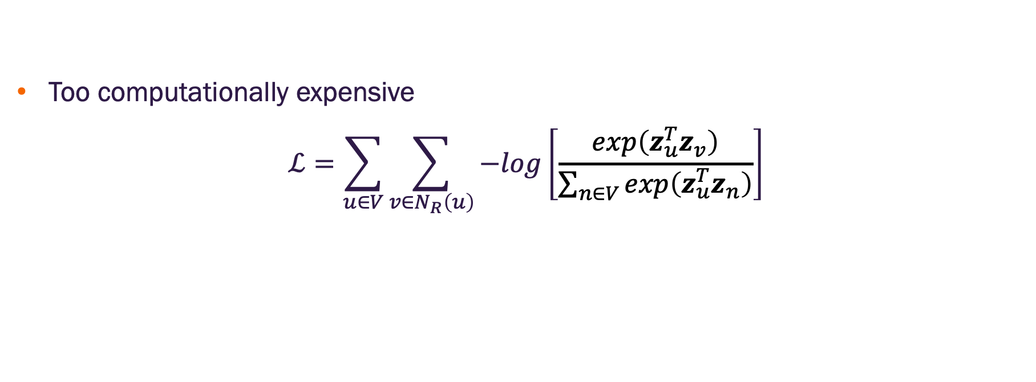
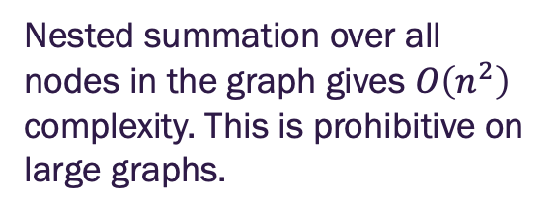
Random walk embedding optimization by maximum likelihood
Too computationally expensive
$$ℒ=\sum_{u∈V}{\sum_{v∈N_{R}\left(u\right)}{−log\left[\frac{exp\left(z_{u}^{T}z_{v}\right)}{\sum_{n∈V}{exp\left(z_{u}^{T}z_{n}\right)}}\right]}}$$
Nested summation over all nodes in the graph gives $O\left(n^{2}\right)$ complexity. This is prohibitive on large graphs.

Slide 28
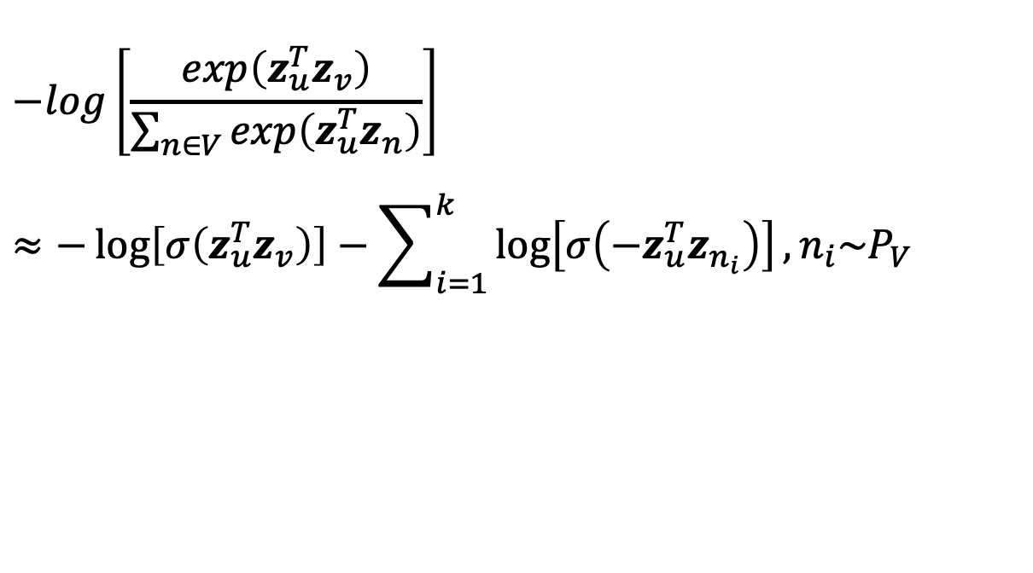
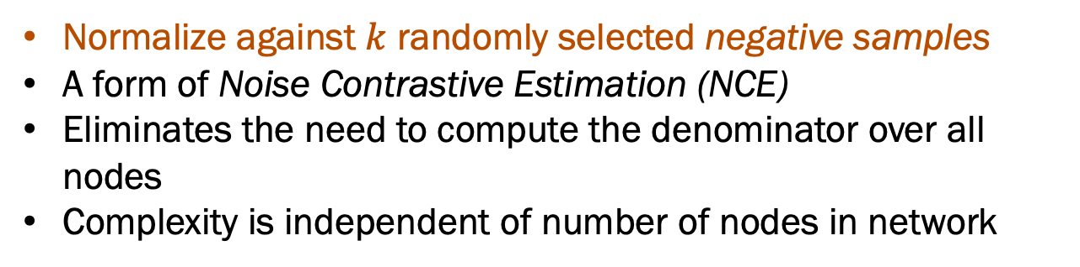
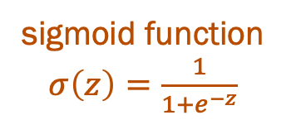
Negative sampling
Revise our loss function using the approximation*
$$−log\left[\frac{exp\left(z_{u}^{T}z_{v}\right)}{\sum_{n∈V}{exp\left(z_{u}^{T}z_{n}\right)}}\right]$$
$$≈−\log\left[σ\left(z_{u}^{T}z_{v}\right)\right]−\sum_{i=1}^{k}{\log\left[σ\left({−z}_{u}^{T}z_{n_{i}}\right)\right]}, n_{i}\sim P_{V}$$
random distribution over all nodes
sigmoid function $σ\left(z\right)=\frac{1}{1+e^{−z}}$
Normalize against $k$ randomly selected negative samples
A form of Noise Contrastive Estimation (NCE)
Eliminates the need to compute the denominator over all nodes
Complexity is independent of number of nodes in network
*See https://arxiv.org/pdf/1402.3722

Slide 29
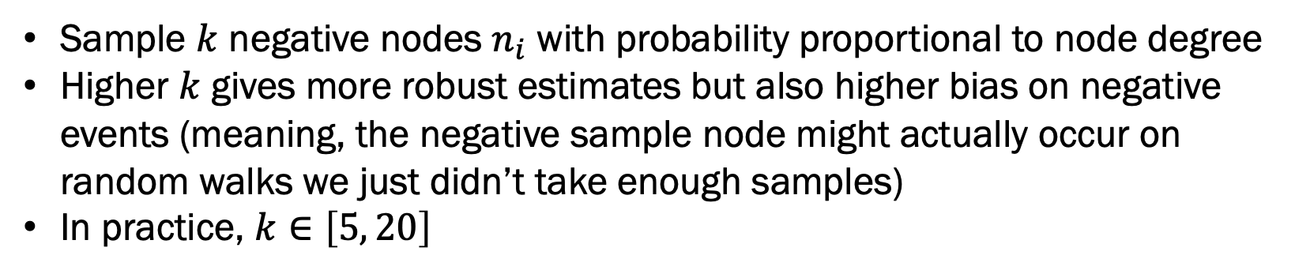
Negative sampling
Revise our loss function using the approximation*
$$−log\left[\frac{exp\left(z_{u}^{T}z_{v}\right)}{\sum_{n∈V}{exp\left(z_{u}^{T}z_{n}\right)}}\right]$$
$$≈−\log\left[σ\left(z_{u}^{T}z_{v}\right)\right]−\sum_{i=1}^{k}{\log\left[σ\left({−z}_{u}^{T}z_{n_{i}}\right)\right]}, n_{i}\sim P_{V}$$
Sample $k$ negative nodes $n_{i}$ with probability proportional to node degree
Higher $k$ gives more robust estimates but also higher bias on negative events (meaning, the negative sample node might actually occur on random walks we just didn’t take enough samples)
In practice, $k∈\left[5, 20\right]$
*See https://arxiv.org/pdf/1402.3722

Slide 30
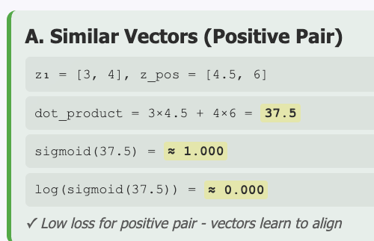
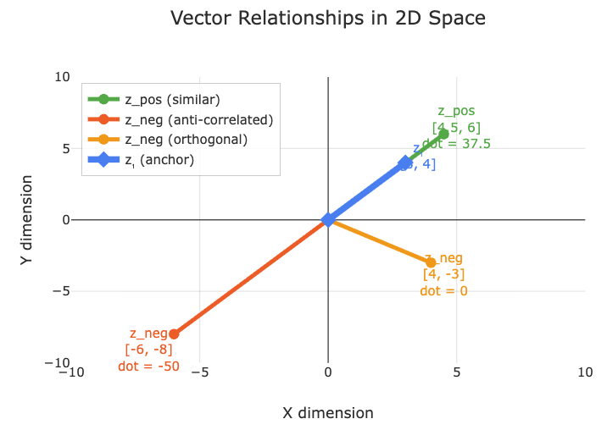
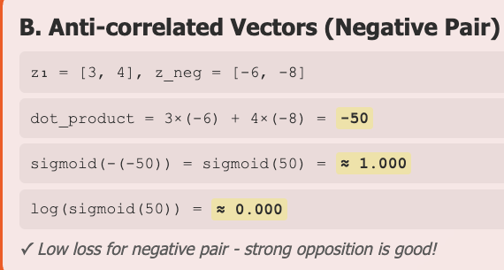
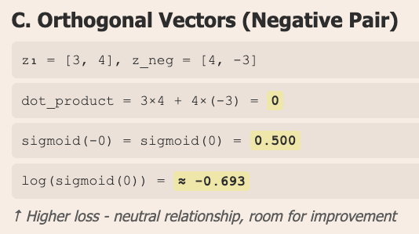
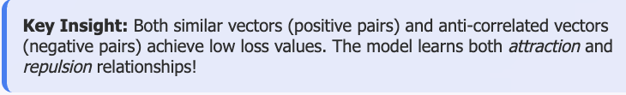
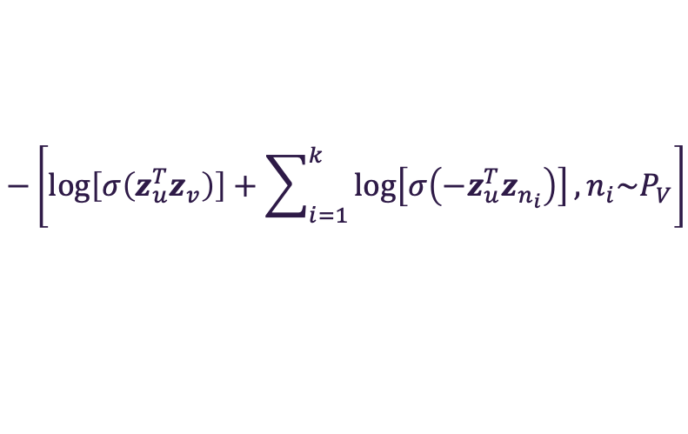
Understanding NCE loss
$$−\left[\log\left[σ\left(z_{u}^{T}z_{v}\right)\right]+\sum_{i=1}^{k}{\log\left[σ\left({−z}_{u}^{T}z_{n_{i}}\right)\right]}, n_{i}\sim P_{V}\right]$$

Slide 31
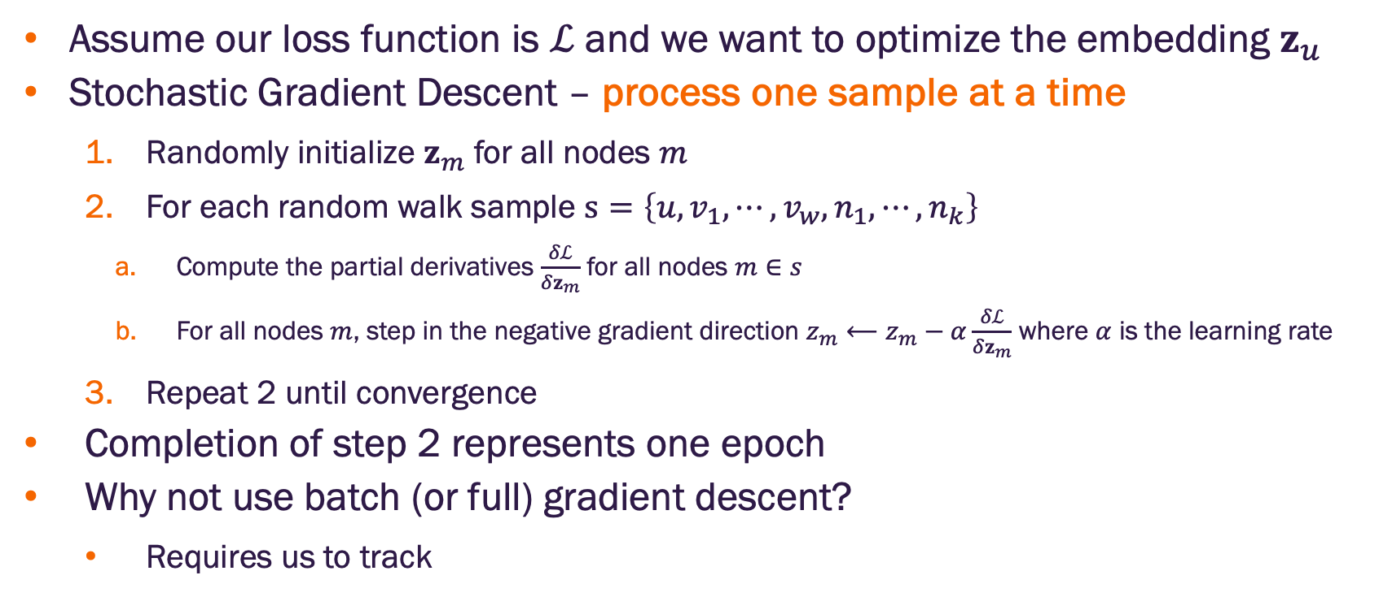
How do we optimize our objective function?
Assume our loss function is $ℒ$ and we want to optimize the embedding $z_{u}$
Stochastic Gradient Descent – process one sample at a time
Randomly initialize $z_{m}$ for all nodes $m$
For each random walk sample $s=\left\{u, v_{1},⋯,v_{w},n_{1},⋯,n_{k}\right\}$
Compute the partial derivatives $\frac{δℒ}{δz_{m}}$ for all nodes $m∈s$
For all nodes $m$, step in the negative gradient direction $z_{m}⟵z_{m}−α\frac{δℒ}{δz_{m}}$ where $α$ is the learning rate
Repeat 2 until convergence
Completion of step 2 represents one epoch
Why not use batch (or full) gradient descent?
Requires us to track
Notes:
Why not use batch (or full) gradient descent - requires computationally expensive bookkeeping
The Complete Bookkeeping Requirements
For every node X in the graph, the total gradient would be:
∂L_total/∂X = Σ(all samples where X appears) ∂L_sample/∂X
This includes:
1. When X is a Center Node
For every positive pair (X, v) where X is the center:
∂L/∂X from the positive term: -log σ(v·X)
∂L/∂X from all k negative terms: -Σᵢ log σ(-nᵢ·X)
2. When X is a Context Node
For every positive pair (u, X) where X is the context:
∂L/∂X from the positive term: -log σ(X·u)
3. When X is a Negative Sample
For every pair (u, v) where X was randomly selected as a negative:
∂L/∂X from the negative term: -log σ(-X·u)
Concrete Example
Let's say node X appears in your dataset as:
Center node in: (X, v1), (X, v2), (X, v3)
Context node in: (u1, X), (u2, X)
Negative sample for: (u3, v4), (u5, v6), (u7, v8)
Then:
∂L_total/∂X = ∂L₁/∂X + ∂L₂/∂X + ∂L₃/∂X + # center terms ∂L₄/∂X + ∂L₅/∂X + # context terms ∂L₆/∂X + ∂L₇/∂X + ∂L₈/∂X # negative terms
Why This is Computationally Expensive
Tracking: You need to track every occurrence of every node across all samples
Memory: Store partial derivatives from potentially thousands of samples per node
Computation: Sum gradients across all these occurrences before any update
Synchronization: All gradients must be computed before any embeddings can be updated

Slide 32
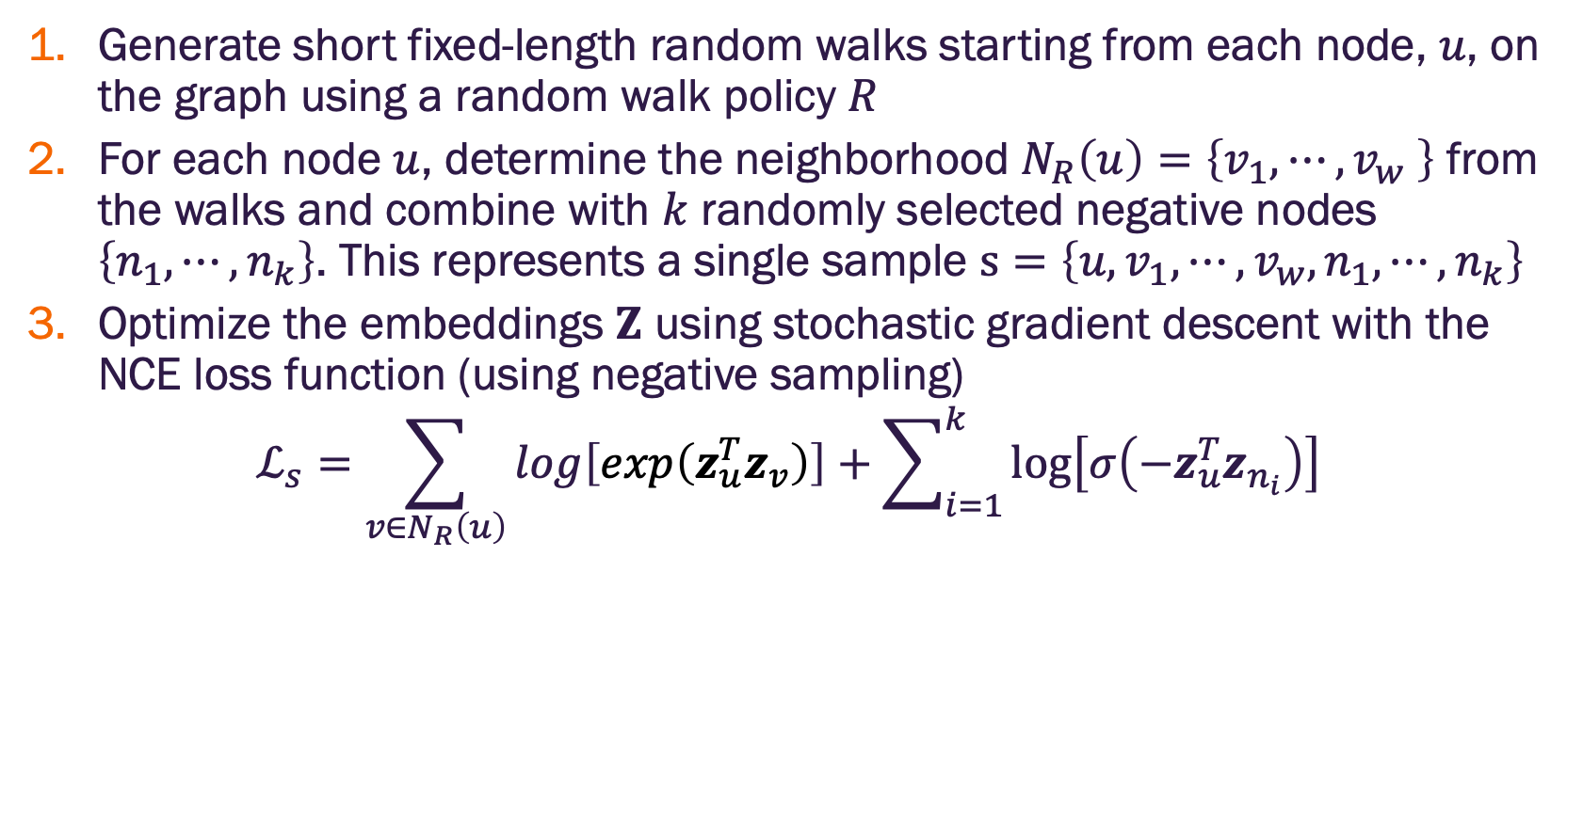
Random walk summary
Generate short fixed-length random walks starting from each node, $u$, on the graph using a random walk policy $R$
For each node $u$, determine the neighborhood $N_{R}\left(u\right)=\left\{v_{1},⋯,v_{w} \right\}$ from the walks and combine with $k$ randomly selected negative nodes $\left\{n_{1},⋯,n_{k}\right\}$. This represents a single sample $s=\left\{u, v_{1},⋯,v_{w},n_{1},⋯,n_{k}\right\}$
Optimize the embeddings $Z$ using stochastic gradient descent with the NCE loss function (using negative sampling)
$$ℒ_{s}=\sum_{v∈N_{R}\left(u\right)}{log\left[exp\left(z_{u}^{T}z_{v}\right)\right]+\sum_{i=1}^{k}{\log\left[σ\left({−z}_{u}^{T}z_{n_{i}}\right)\right]}}$$

Slide 33
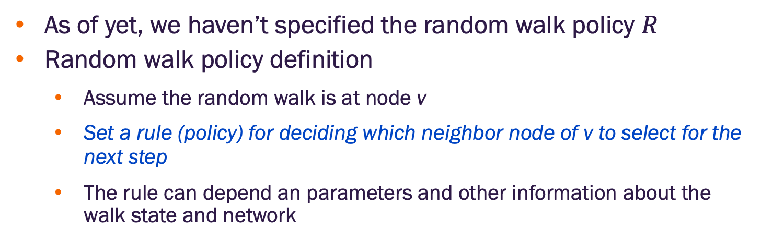
What is a random walk policy?
As of yet, we haven’t specified the random walk policy $R$
Random walk policy definition
Assume the random walk is at node v
Set a rule (policy) for deciding which neighbor node of v to select for the next step
The rule can depend an parameters and other information about the walk state and network
3
4
v
5
1
2

Slide 34
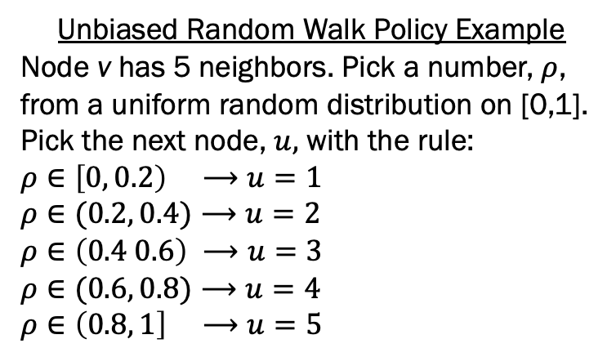
How do we pick the random walk policy?
Simplest approach is to select the next node in the walk from the neighbors of the current node with equal probability
Unbiased random walk
This was proposed for DeepWalk by Perozzi et al.
This turns out to be too restrictive
How can we improve this?
Unbiased Random Walk Policy Example
Node v has 5 neighbors. Pick a number, $ρ$, from a uniform random distribution on [0,1]. Pick the next node, $u,$ with the rule:
$$ρ∈\left[0, 0.2\right) ⟶u=1$$
$$ρ∈(0.2, 0.4)⟶u=2$$
$$ρ∈\left(0.4 0.6\right) ⟶u=3$$
$$ρ∈(0.6, 0.8)⟶u=4$$
$$ρ∈\left(0.8, 1\right] ⟶u=5$$
3
4
v
5
1
2

Slide 35

Breadth and depth first search
Breadth-first is a walk policy that favors a local neighborhood view
Depth-first is a walk policy that favors a global neighborhood views
We would like a walk policy that combines these
Next, we discuss node2vec which uses a parameterized bias random walk policy that interpolates between breadth-first (local) and depth-first (global) views of a node neighborhood
Image credit: Grover & Leskovec 2016

Slide 36

node2vec uses a biased random walk policy
Biased random walk concept
Assume the random walk just traversed the edge from node t to node v
Bias the probability of picking a neighbor of node $v$ based on whether it is
The previous node
A neighbor of the previous node
Not a neighbor of the previous node
How do we bias the probability?
2
4
Neighbors that are not neighbors of the previous node (out)
Neighbors that are neighbors of the previous node (in)
v
previous
node
3
t
1
current
node

Slide 37





node2vec uses a biased random walk policy
Biased probabilities
Assume the random walk just traversed the edge from node t to node v
Select policy parameters $p$ and $q$ (more on these later)
For node $x$ in set of neighbors of $v$
Let $w_{vx}$ be the weight on the edge between nodes $v$ and $x$ (unweighted $w_{vx}=1$)
Let $d_{tx}$ be the shortest path distance from node $t$ to node $x$ ($d_{tx}$ is 0, 1, or 2)
Set the unnormalized transition probability to $π_{vx}=α_{pq}\left(t,x\right)∙w_{vx}$
Normalize the transition probabilities by $\sum_{x∈N\left(v\right)}{π_{vx}}$
$$α_{pq}\left(t,x\right)=\left\{\begin{matrix}\frac{1}{p} if d_{tx}=0 \\ 1 if d_{tx}=1 \\ \frac{1}{q} if d_{tx}=2\end{matrix}\right.$$
2
4
$$d_{tx}=2$$
$$d_{tx}=1$$
v
$$d_{tx}=0$$
3
t
1
current
node

Slide 38







node2vec biased random walk step example
Let $Π_{v}=\sum_{x∈N\left(v\right)}{π_{vx}}$ be the sum of the unnormalized transition probabilities $π_{vx}=α_{pq}\left(t,x\right)∙w_{vx}$ so that the normalized transition probability from node $v$ to $x$ is $ψ_{vx}={π_{vx}}/{Π_{v}}$.
Example
Let $w_{vx}=1$ for all $x$ (unweighted)
Let $p=0.5$ and $q=0.25$
$π_{vt}=2$, $π_{v1}=π_{v2}=1$, $π_{v3}=π_{v4}=4$
$$Π_{v}=\sum_{x∈N\left(v\right)}{π_{vx}}=2+2∙1+2∙4=12$$
$$α_{pq}\left(t,x\right)=\left\{\begin{matrix}\frac{1}{p} if d_{tx}=0 \\ 1 if d_{tx}=1 \\ \frac{1}{q} if d_{tx}=2\end{matrix}\right.$$
Pick a number, $ρ$, from a uniform random distribution on [0,1]. Pick the next node, $u,$ with the rule:
$$ρ∈\left[0, 1/{12}\right) ⟶u=1$$
$$ρ∈\left(1/{12},2/{12}\right) ⟶u=2$$
$$ρ∈\left(2/{12},4/{12}\right) ⟶u=t$$
$$ρ∈\left(4/{12},8/{12}\right) ⟶u=3$$
$$ρ∈\left(8/{12},1\right] ⟶u=4$$
2
4
$$ψ_{vx}=4/{12}$$
$$ψ_{vx}=1/{12}$$
v
$$ψ_{vx}=2/{12}$$
3
t
1
current
node
https://ml4g.masinolab.com/topics/shallow-embeddings/node2vec.html

Slide 39

node2vec uses a biased random walk policy
Random walk policy parameters
In-out parameter $q$: scales the probability of staying in (BFS) the previous node’s neighbors vs. moving out (DFS) of the previous node’s neighbors (DFS)
Setting $q>1$ encourages BFS and $q<1$ encourages DFS (we saw this in the previous example)
Return parameter $p$: scales the probability of returning to the previous node in a walk
Setting $p>max⁡(q,1)$ discourages backtracking, setting $p<min⁡(q,1)$ encourages backtracking, otherwise $min\left(q,1\right)<p<max⁡(q,1)$ has moderate backtracking
https://ml4g.masinolab.com/topics/shallow-embeddings/node2vec.html

Slide 40

node2vec context sampling
Assume we have created a large number of random walks with the node2vec biased walk policy
How do we use them to create samples?
Consider a single random walk
Set the context window length $w$
Pick a center node, $u$, in the walk
Let every node, $v$, that is within $w$ steps to $u$ be a context node
Form positive pairs $\left(u,v\right)$ for $u$ and every context node
Form a single sample as the set of positive pairs and $k$ randomly sampled negative nodes (i.e., those not in the graph that are not in the context nodes)
https://ml4g.masinolab.com/topics/shallow-embeddings/node2vec.html

Slide 41





node2vec context sampling
A single random walk of length 6
https://ml4g.masinolab.com/topics/shallow-embeddings/node2vec.html

Slide 42






node2vec context sampling
Each row is a single sample for SGD
https://ml4g.masinolab.com/topics/shallow-embeddings/node2vec.html

Slide 43

node2vec algorithm summary
Precompute edge transition probabilities for all edges
Generate $r$ random walks of length $l$ for every node in the graph using the bias random walk policy
Use context sampling to generate samples where each sample include positive pairs $\left(u,v_{w}\right)$ and $k$ negative nodes
Apply SGD over each sample using NCE with negative sampling loss
Linear time complexity
All steps are individually parallelizable
https://ml4g.masinolab.com/topics/shallow-embeddings/node2vec.html

Slide 44
Random walk variants
Different kinds of biased random walks:
Based on node attributes (Dong et al.)
Based on learned weights (Abu-El-Haija et al.)
Alternative optimization schemes:
Directly optimize based on 1-hop and 2-hop random walk probabilities (as in LINE from Tang et al.)
Network preprocessing techniques:
Run random walks on modified versions of the original network (e.g., Ribeiro et al. struct2vec, Chen et al. HARP)

Slide 45
Summary so far
Core idea: Embed nodes so that distances in embedding space reflect node similarities in the original network
Different notions of node similarity:
Naïve: Similar if two nodes are connected
Random walk approaches

Slide 46
Summary so far
So, what method should I use..?
No one method wins in all cases….
E.g., node2vec performs better on node classification while alternative methods perform better on link prediction (Goyal and Ferrara, survey)
Random walk approaches are generally more efficient
In general: Must choose definition of node similarity that matches your application

Slide 47
Graph Embeddings

Slide 48


Embedding an entire graph
Goal: Embed a subgraph (or the entire graph) $G$ in the embedding space
Motivation: Classify or cluster networks
Examples: candidate drug targets, anomalous networks
$$z_{G}$$
embedding space

Slide 49




Node averaging for graph embedding
Apply a node embedding algorithm to all nodes in $G$
Average the node embeddings to obtain a single embedding for $G$
The average is done element wise
3
node 1 embedding
node 2 embedding
node 3 embedding
$$G$$
1
$G$ embedding
2
position i in $G$ embedding is the average of the embedding values at position i from the node embeddings

Slide 50
Virtual nodes for graph embedding
Create a virtual node and connect all nodes in the subgraph (or entire graph) to the virtual node
Run a node embedding method to obtain the embedding for the virtual node
$$z_{G}$$
embedding space

Slide 51
Limitations of matrix factorization and random walk embeddings

Slide 52

Matrix factorization and random walk embedding methods are transductive
Transductive (not inductive) method:
Cannot obtain embeddings for nodes not in the training set
Cannot apply to new graphs using the same nodes or the same graph with updated edges
If you apply a random walk method to the same graph multiple times, you’ll get a different embedding each time. Why?
Image credit: Jure Leskovec, http://cs224w.stanford.edu

Slide 53

Random walk embedding methods cannot capture structural similarity
DeepWalk and node2vec do not capture structural similarity
Consider the network below
Node 1 and 11 are structurally similar – part of one triangle, degree 2, …
However, they have very different random walk embeddings.
Why? It’s unlikely that a random walk will reach node 11 from node 1
Image credit: Jure Leskovec, http://cs224w.stanford.edu

Slide 54

Matrix factorization and random walk embedding methods cannot use node, edge, or graph features
Node feature vector
(e.g. protein properties in a protein-protein interaction graph)
Matrix factorization / random walk embeddings do not incorporate such node features
Solution: Graph neural networks
Image credit: Jure Leskovec, http://cs224w.stanford.edu

Slide 55

What can we do with node embeddings?
Clustering/community detection: Cluster points $z_{n}$
Node classification: Predict label of node $n$ based on $z_{n}$
Link prediction: Predict edge $\left(u,v\right)$based on a function of $f\left(g\left(z_{u},z_{v}\right)\right)$ where the function $g$ is usually on of vector concatenation, averaging, Hadamard product, or difference
Graph classification: Predict label based on graph embedding, $z_{G}$, formed via aggregating node embeddings or virtual-node

Slide 56


